Slide 1
Mastering SQL Server Audits
From Native Capabilities to Enterprise-Grade Compliance

Slide 2
Links for this Session/Workshop
Scripts and Slide Decks
tba
ERP Demo Database (17.00 GB)
https://db-berater.de/downloads/ERP_Demo.bak
SQLQueryStress
https://github.com/ErikEJ/SqlQueryStress
Windows Admin Center
https://go.microsoft.com/fwlink/?linkid=2220149

Slide 3

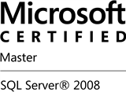
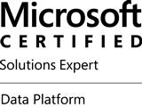

Uwe Ricken db Berater GmbH
I am working with IT-systems since early 1990's and with the main focus on Microsoft SQL Server since version 6.0. I started with development of database applications in 1998 with a professional CRM-System based on Microsoft products (Microsoft Office and Microsoft SQL Server).
Since 2008 I'm focused exclusively on Microsoft SQL Server and working in 3rd level support teams for banks, insurances and global industries.
Since May 2013 I am a Microsoft Certified Master: SQL Server 2008 which was an amazing way into the depth of Microsoft SQL Server.
In July 2013 I have been awarded with the MVP Award for Microsoft SQL Server.
www: http://www.db-berater.de
email: uwe.ricken@db-berater.de
blog: http://www.sqlmaster.de
BlueSky: @sqlbambi

Slide 4
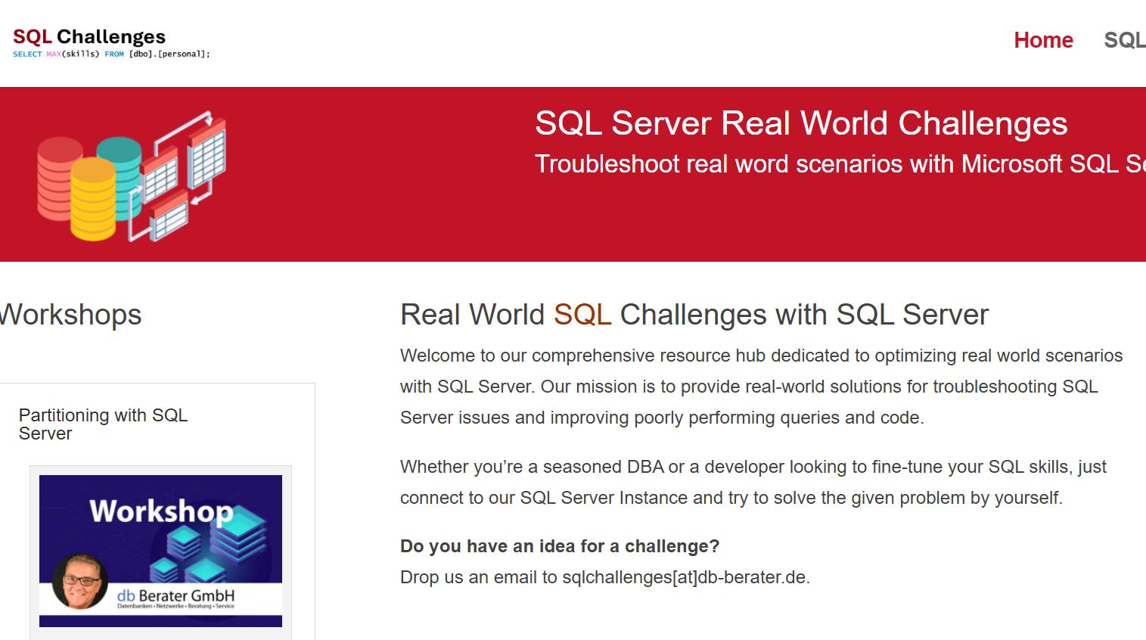
Challenge SQL Server real world scenarios
Get a challenge at least once a month
Connect to a provided SQL Server Instance
Load the challenge scenario
Try to solve it
Blog about your solution
Leave a link in the comments of the challenge to your blog post.
https://sqlchallenges.de

Slide 5
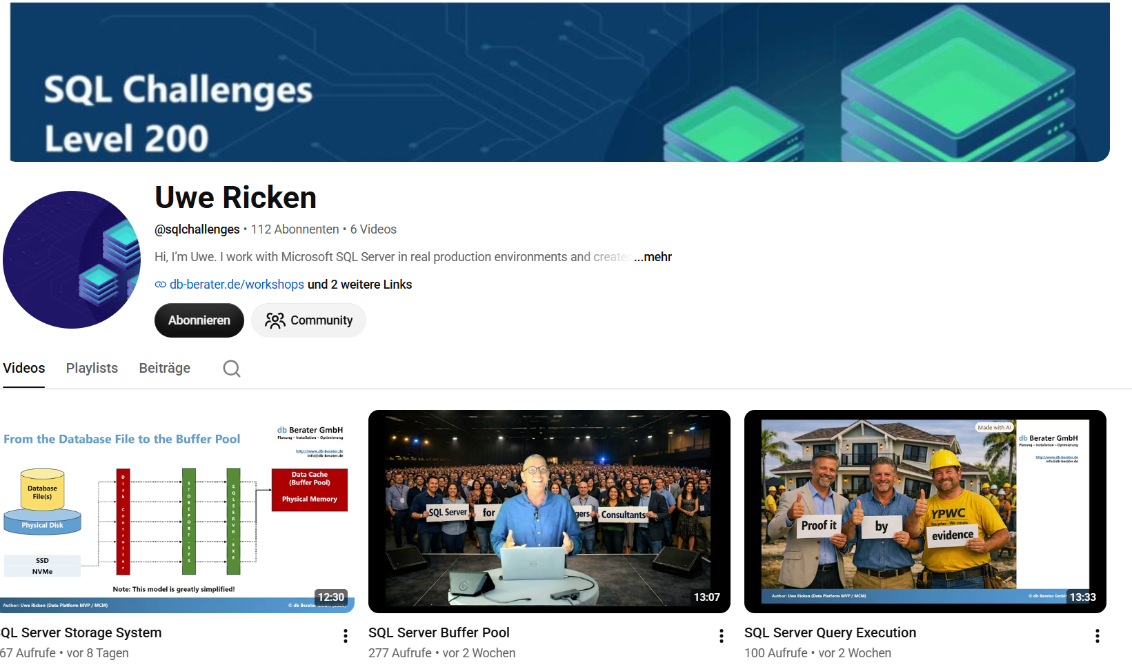
SQL Server for Juniors, Managers & Consultants
Learn SQL Server concepts through relatable real‑world analogies
Understand engine behavior without deep technical prerequisites
Bridge the gap between technical and non‑technical roles
Make performance, security, and architecture decisions easier to grasp
Build lasting intuition by connecting SQL Server to everyday situations
https://www.youtube.com/@sqlchallenges

Slide 6
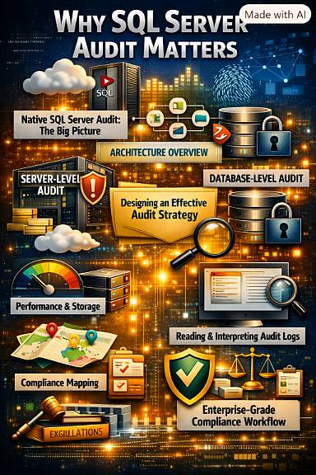
Agenda
Why SQL Server Audit Matters
Native SQL Server Audit: The Big Picture
Architecture Overview
Server-Level Audit Deep Dive
Database-Level Audit Deep Dive
Performance & Storage Considerations
Reading & Interpreting Audit Logs
Compliance Mapping
Enterprise-Grade Compliance Workflow

Slide 7
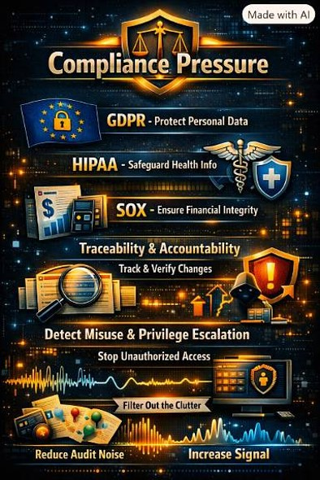
Why SQL Server Audit Matters
Compliance pressure:
  GDPR privacy and personal data
  HIPAA Health Insurance Portability and Accountability Act
  SOX financial fraud and corporate financial reporting
Traceability & accountability
Detect misuse & privilege escalation
Reduce audit noise → increase signal
Notes:
000 - Basics about relations indexes partitions allocation units pages etc.sql

Slide 8
SQL Server auditing features
SQL Server Audit (Native Feature)
Benefits
  Fully integrated with the engine
  (no external dependencies).
  Can write to
    File
    Windows Application Log
    Security Log.
  Meets compliance standards
    GDPR
    HIPAA
    SOX
Drawbacks
  Limited flexibility in filtering
  (especially pre‑SQL 2019).
  Can generate large volumes of data Performance overhead if auditing too many actions.
  No native visualization or analytics.

Slide 9
SQL Server auditing features
Extended Events (XEvents)
Benefits
  Extremely granular - captures almost any internal event.
  Lower overhead than traditional trace or audit.
  Can integrate with custom dashboards or automation.
  Ideal for forensic troubleshooting and performance correlation.
Drawbacks
  Complex to configure and interpret for non‑DBAs.
  Not designed for compliance reporting
  Requires manual retention and security hardening.

Slide 10
SQL Server auditing features
SQL Trace / Profiler (Legacy)
Benefits
  Simple to use and visualize in SQL Profiler.
  Useful for quick debugging or ad‑hoc analysis.
Drawbacks
  Deprecated - replaced by Extended Events.
  High performance overhead.
  Not suitable for production auditing or compliance.
  No fine‑grained security or tamper protection.
What have ALL these solutions in common?
No Separation Of Duty because the DBA is the sysadmin!
Set a fox to guard the henhouse!

Slide 11
SQL Server auditing features
Third‑Party Audit Tools
Benefits
  Centralized dashboards, alerting, and compliance mapping.
  Easier reporting for auditors and management.
  Can correlate multiple SQL instances.
Drawbacks
  Licensing cost.
  Additional configuration and agent overhead.
  Dependency on vendor updates.

Slide 12
Auditing Tools
Product / Tool | GDPR | HIPAA | SOX | PCI / DSS | Notes
Idera SQL Compliance Manager | √ | √ | √ | √ | Full enterprise auditing + compliance reports
DBLense SQL Server Auditor | √ | √ | √ | √ | Real-time-auditing + SIEM integration
DataSunrise Security Suite | √ | √ | √ | -- | Advanced firewall + masking + auditing
Native SQL Server Audit | √ | √ | √ | -- | Requires correct configuration – no reporting
SIEM appliances (Splunk, QRadar, ArcSight, LogRhythm) can collect audit logs, but they
do not perform SQL Server auditing
do not understand SQL Server object access
do not generate audit events
do not fulfill SQL compliance requirements by themselves
They only consume audit logs produced by SQL Server or an auditing tool.

Slide 13
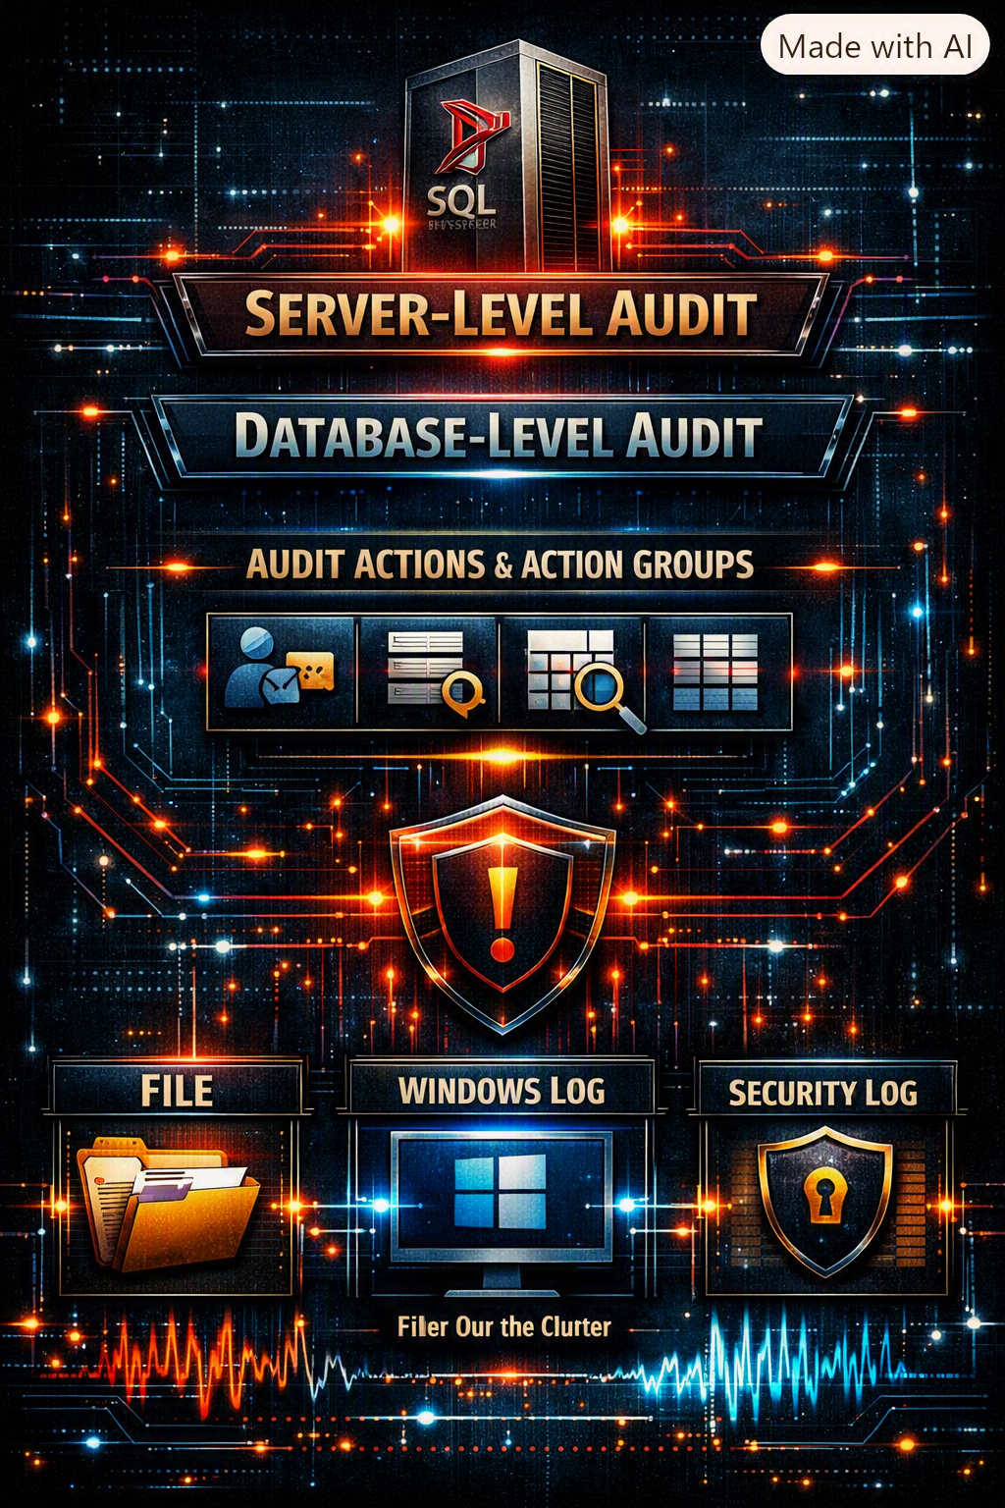
Native SQL Server Audit
Server‑level audit
Database‑level audit
Audit actions & action groups
Audit targets
  File
  Windows log
  Security log

Slide 14
Architecture Overview
SQL Server Audit is built as a layered architecture.
  Defines the audit target
  Controls audit behavior
SQL Server Audit Specification
  Attaches to a Server Audit.
  Contains Audit Actions or Audit Action Groups that apply to the entire SQL Server instance.
Database Audit Specification
  Attaches to a Server Audit.
  Exists per database.
  Contains Audit Actions or Audit Action Groups relevant to database activity.
Server Audit
Permissions
ALTER ANY SERVER AUDIT
CONTROL SERVER
SYSADMIN
Server Audit Specification
Database Audit Specification

Slide 15
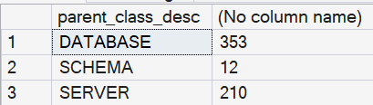
Designing an Effective Audit Strategy
What to audit (principle of minimal logging)
Mapping audit actions to compliance needs
Avoiding “audit everything” traps
Aligning with least privilege

Slide 16


Slide 17
Real World Example
A customer wanted to know when a user with privileged rights access data in a specific database
  Every login with sysadmin permissions must be recorded
  No “regular” user activities must be recorded
No filter can be used in the SERVER AUDIT
  Only names can be filtered
  No (SELECT …) is allowed

Slide 18
Real World Example
Server Audit
CREATE SERVER AUDIT [track sysadmin access]
TO FILE
(
FILEPATH = 'T:\Auditing\Database Audits\SQL_2025\ERP_Demo',
MAXSIZE = 100 MB,
MAX_FILES = 5
)
WITH
(
QUEUE_DELAY = 1000,
ON_FAILURE = CONTINUE
);
GO
Database Audit Specification
CREATE DATABASE AUDIT SPECIFICATION [object access]
FOR SERVER AUDIT [track sysadmin access]
ADD (SELECT ON SCHEMA::[dbo] BY [public]);
ALTER DATABASE AUDIT SPECIFICATION [object access]
WITH (STATE = ON);

